Slide 1
Outlook for 2018
Professor Steven Kyle
Cornell University
January 21, 2018

Slide 2
Grading My Predictions from Last Year
Most economists are taught to avoid naming both a number and a date
I do it anyway every year and post the results on my website
How did I do last time?
Remember, last year I made the predictions only a short time after the totally unexpected results of the 2016 election

Slide 3
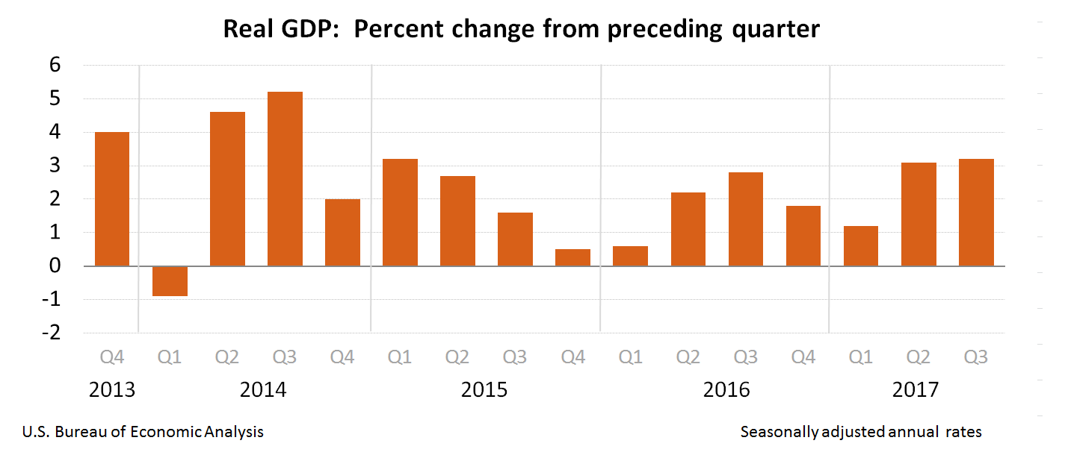
GDP
Prediction was “around 3%” – Q1 not up to that but Q2 & Q3 were

Slide 4
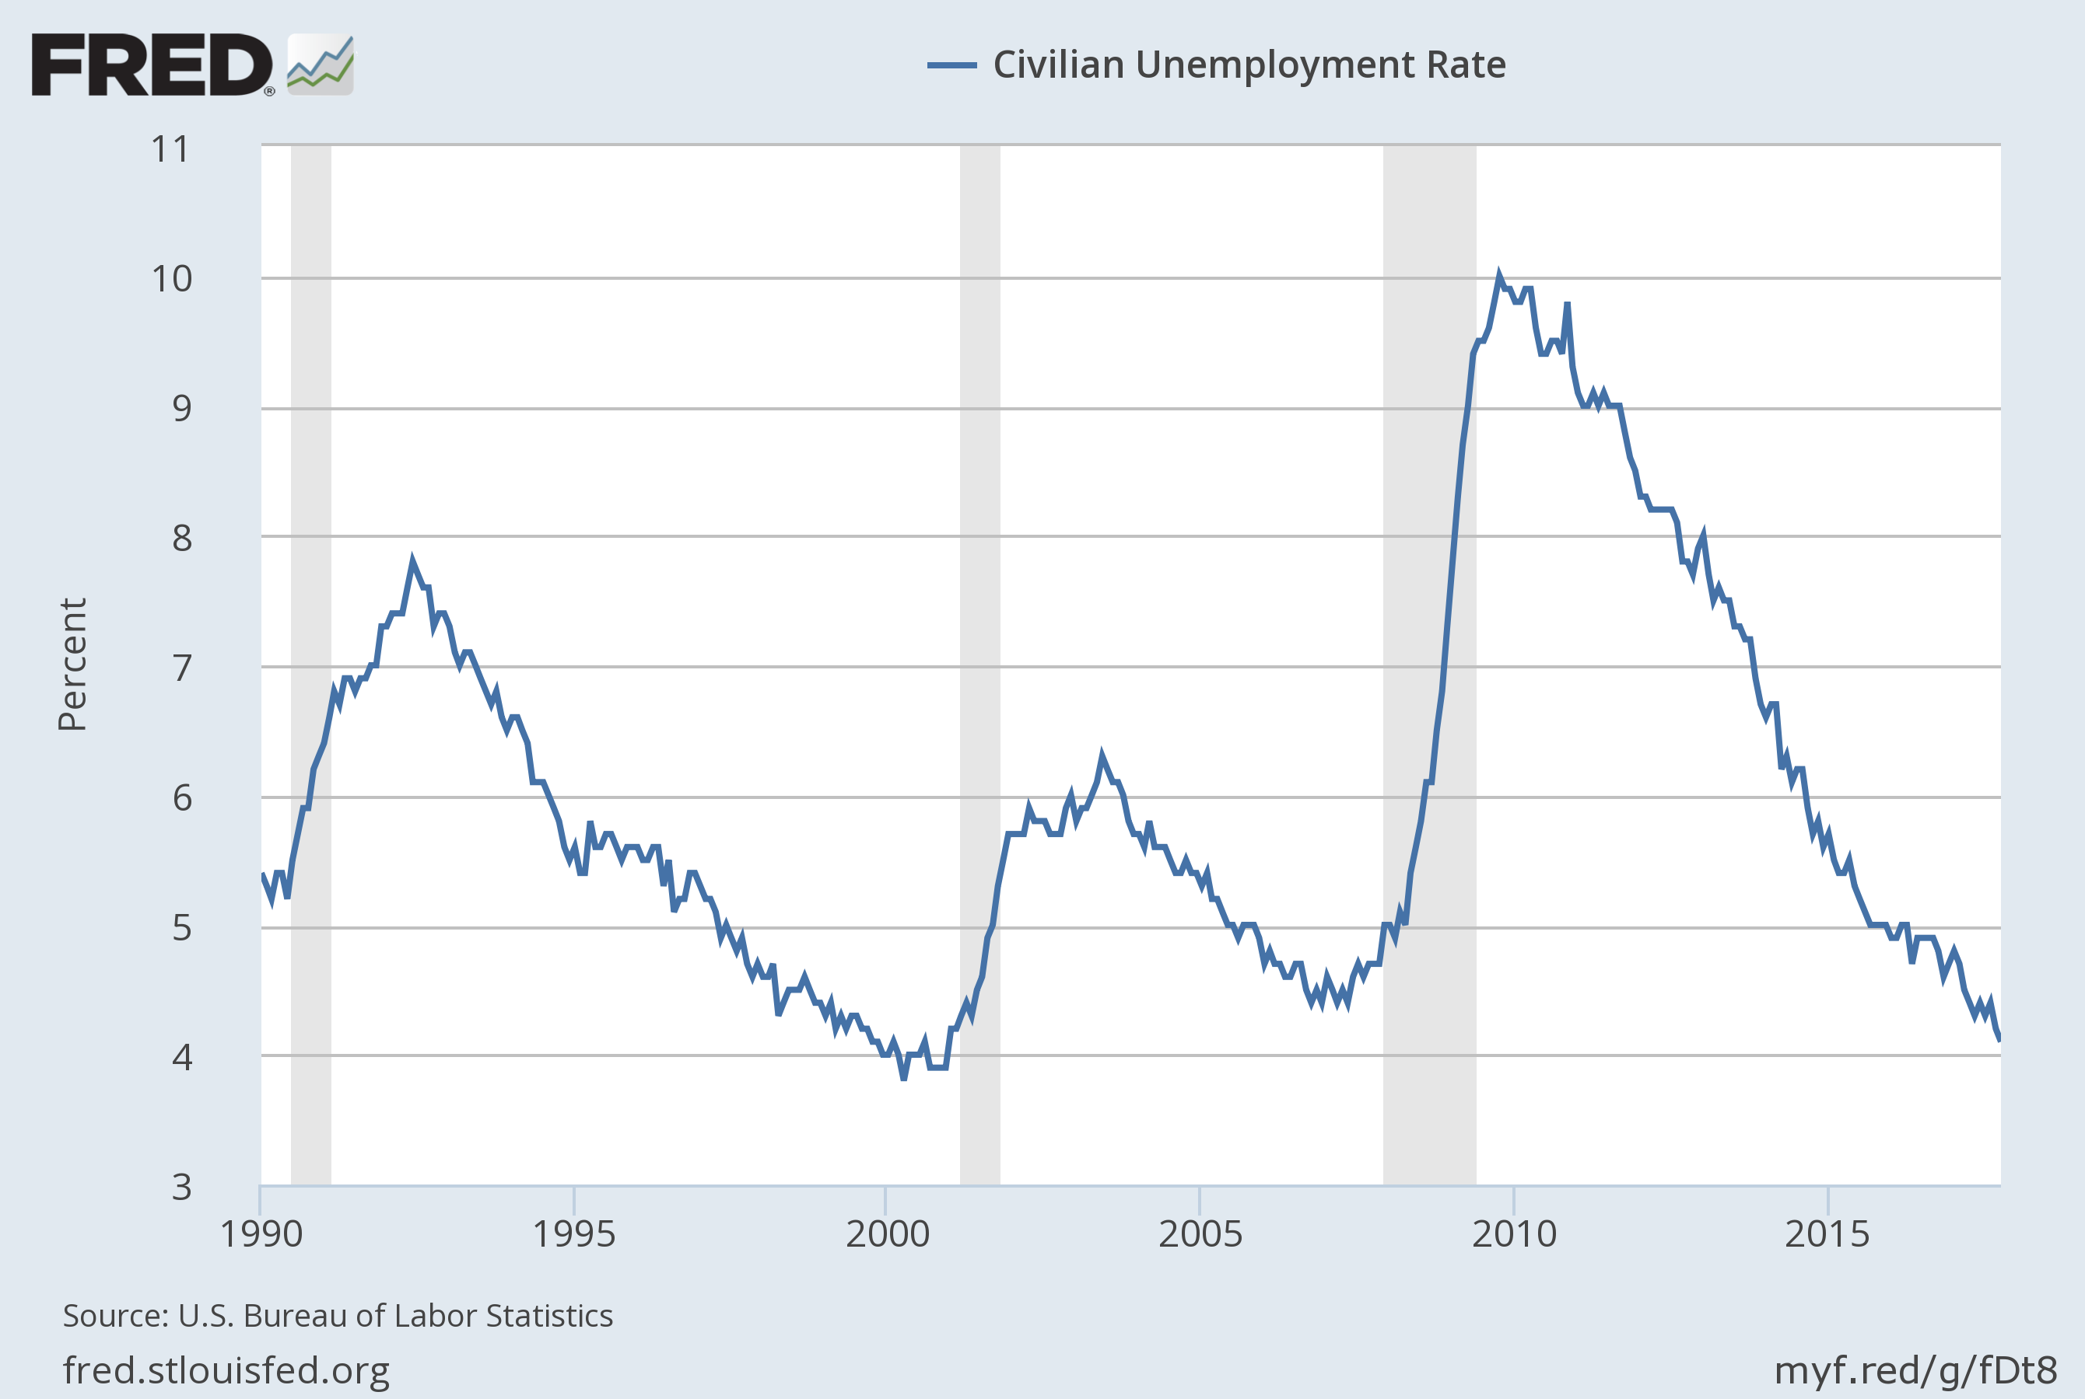
Unemployment Prediction “4 ½ to 5 %” Outcome – 4.1%

Slide 5
Inflation Prediction - “Still not a worry” - Outcome – Indeed, nothing to worry about

Slide 6
Interest rate forecast: “Fed will likely impose rate increases (2-3?)
Next year – but only a ¼% at a time – We will reach 1% at short end
by a year from now” Now at 1.30%

Slide 7
And My Grade for Last Year’s Prediction Is ……
I get a B !!!!!!!!!!!!!!
I was right to count on inertia rather than Trumpian chaos theory but the numbers are what I grade
  GDP prediction a bit high but I may win in the end
  Unemployment prediction pretty far off the mark. More slack in labor marke than I thought
  Inflation prediction spot on
  Interest rate prediction spot on

Slide 8
Where We Are Now: Business Cycle Indicators
Still trudging along in our expansion – Now in 7th year
  Note that there is no “expected length” for a business cycle
We never had a rebound growth spurt and we aren’t going to this time
I can’t help wondering if we are near the peak with unemployment at 4.1%
Housing market more or less “normal”

Slide 9
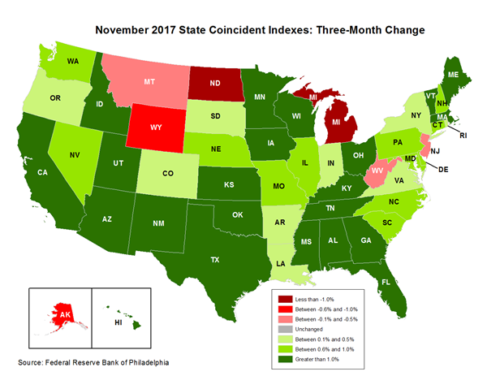
Most Recent Philadelphia Fed Coincident Index (for November)

Slide 10
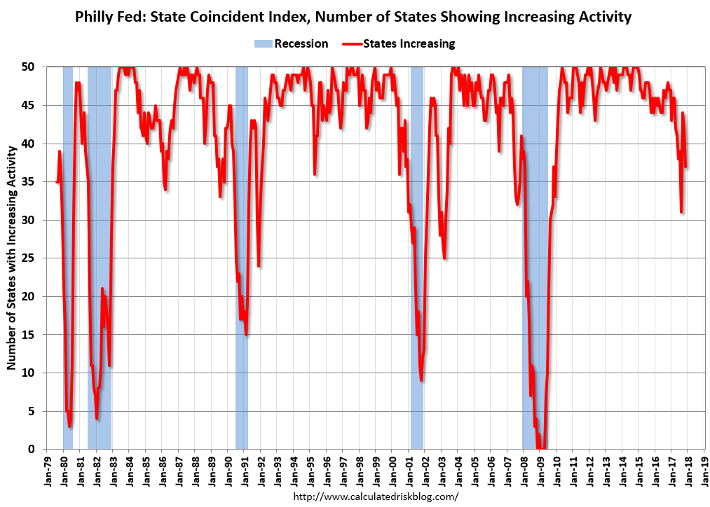

Slide 11
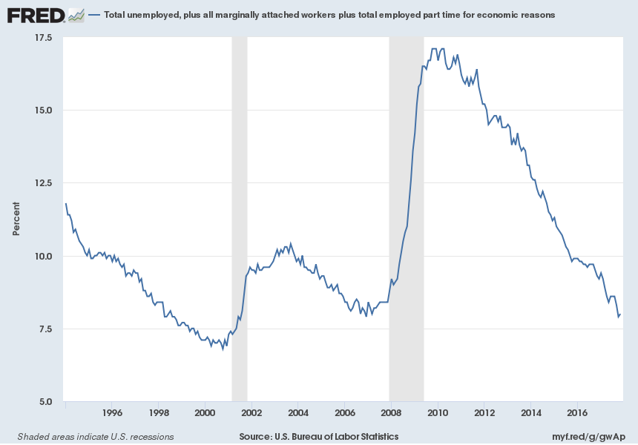
U6 Is Now in a more or less normal range – 8.0%
Notes:
Source:
US. Bureau of Labor Statistics
Release:
Employment Situation
The series comes from the 'Current Population Survey (Household Survey)'The source code is: LNS13327709
US. Bureau of Labor Statistics,
Total unemployed, plus all marginally attached workers plus total employed part time for economic reasons [U6RATE],
retrieved from FRED,
Federal Reserve Bank of St. Louis;
https://fred.stlouisfed.org/series/U6RATE,
November 3, 2016.

Slide 12
Industrial Production Still Not Convincingly Above Previous Peak

Slide 13
Capacity Utilization Still in Mid 70’s Range (With this CU why would we expect
companies to invest overseas cash if we gave them a tax holiday?)

Slide 14
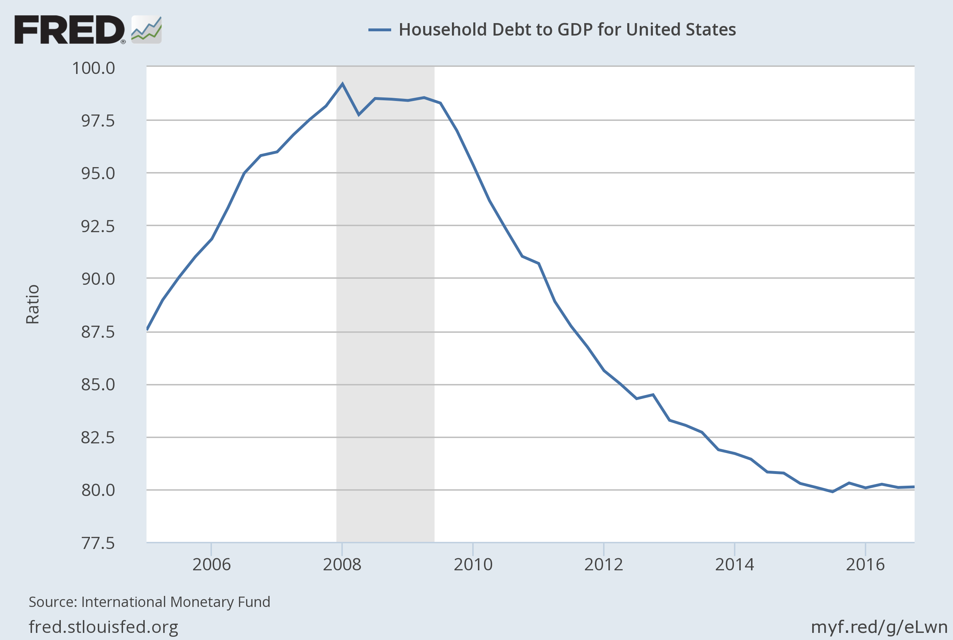
Household Debt Still at Historically Low Levels

Slide 15
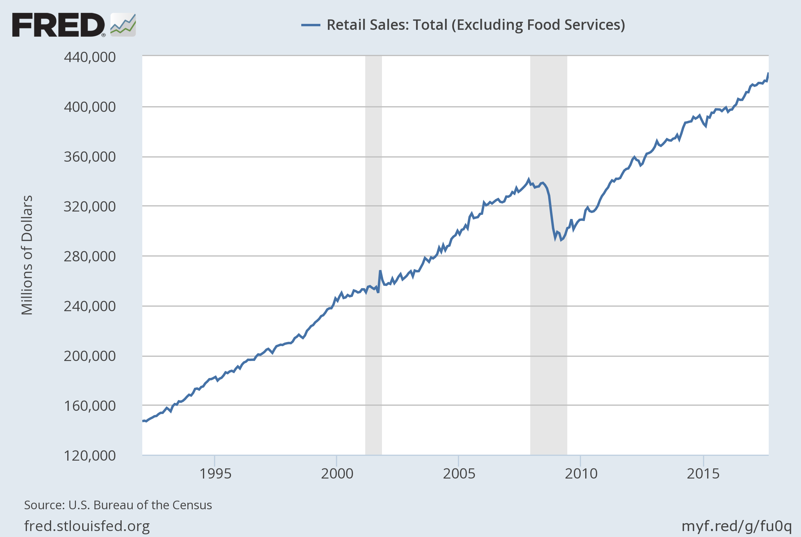
Retail Sales Continue to Rise even if unspectacular
(Remember, this is 70% of GDP)

Slide 16
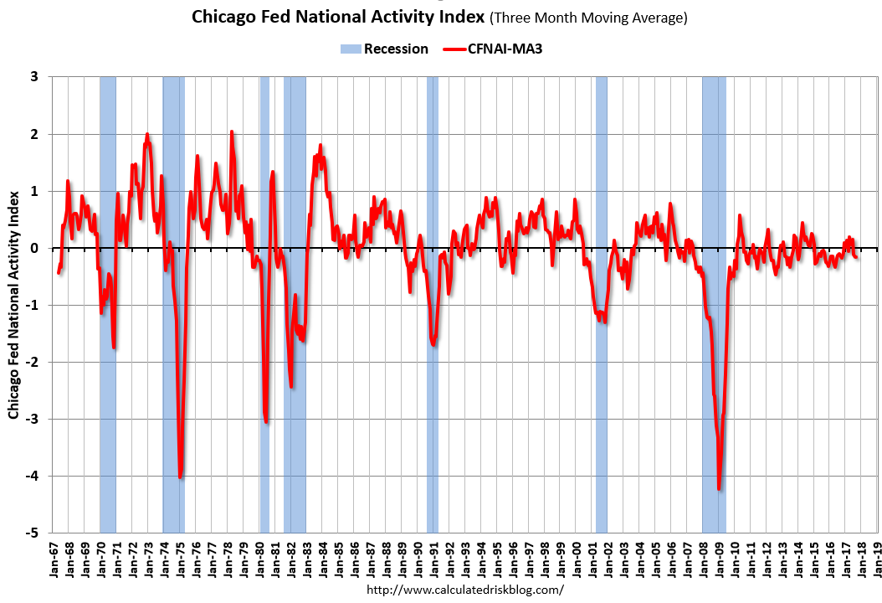
Looking at the Chicago Fed’s Index of National Economic Activity we can see the sharp drop in the recession of ’09
but not much of a bounceback – more of a return to trend

Slide 17
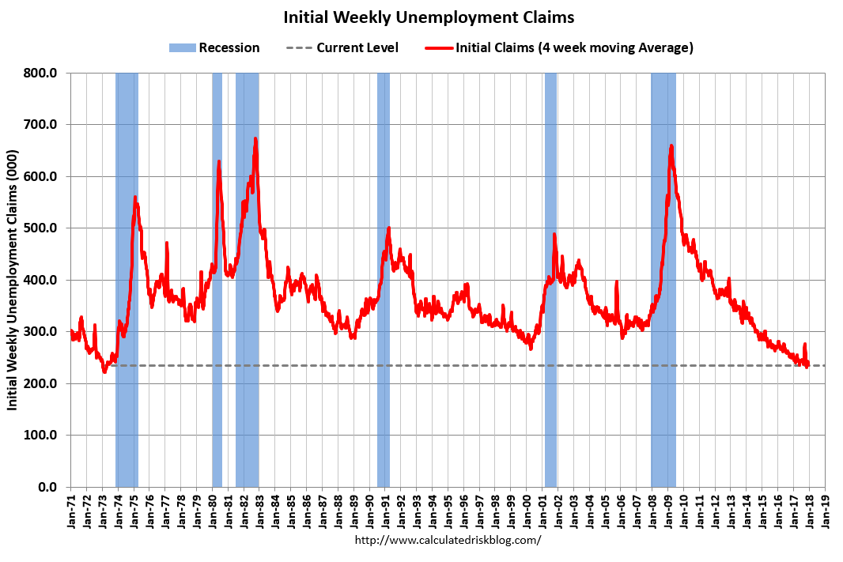
Definitely looks like the labor market is starting to get tighter

Slide 18
Wage Inflation Starting to Pick Up: Not necessarily a bad thing, depending who you are…..

Slide 19
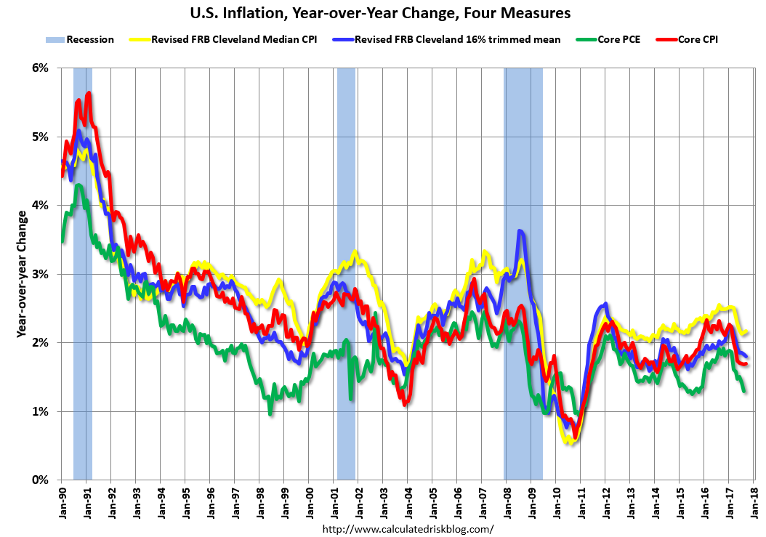
The Fed’s favorite measure is the green line (Core PCE) but most measures still under 2% target

Slide 20
Housing Market
Nominal house prices now more or less up to previous peak (still just a little short in the most bubbly pre-crash markets)
Real prices look OK compared to historical levels
Price/Rent ratio maybe a little high but not too much – New Normal?
New Home Sales now back up to a healthy range – This is what gives a boost to GDP

Slide 21
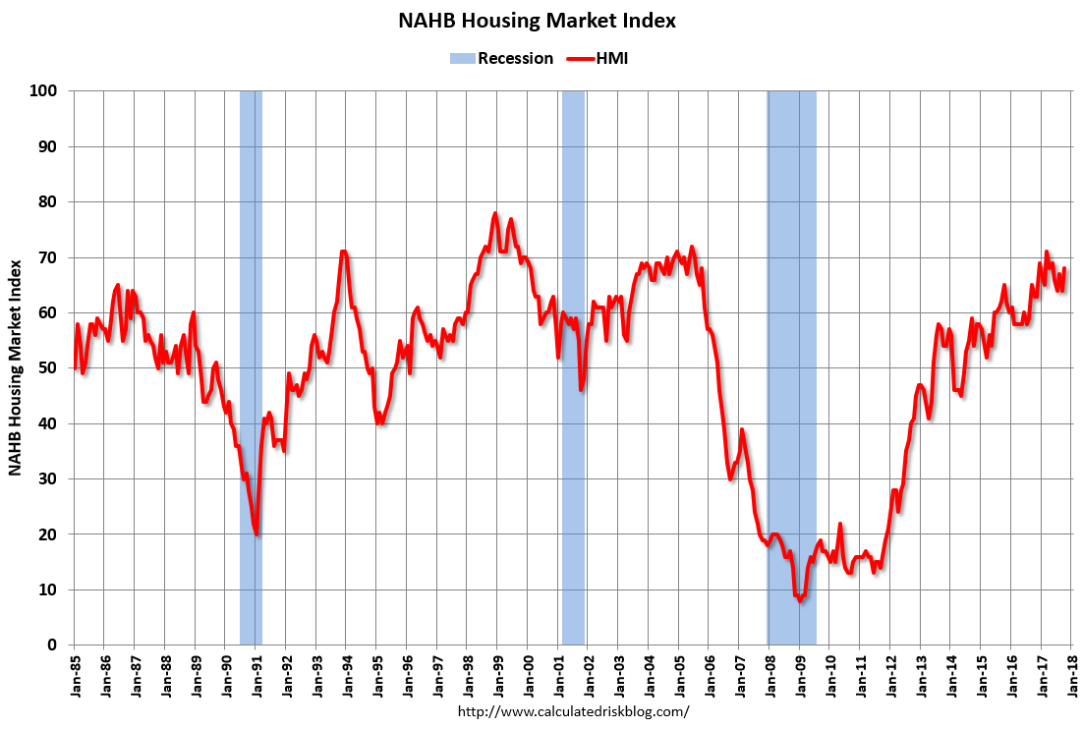

Slide 22
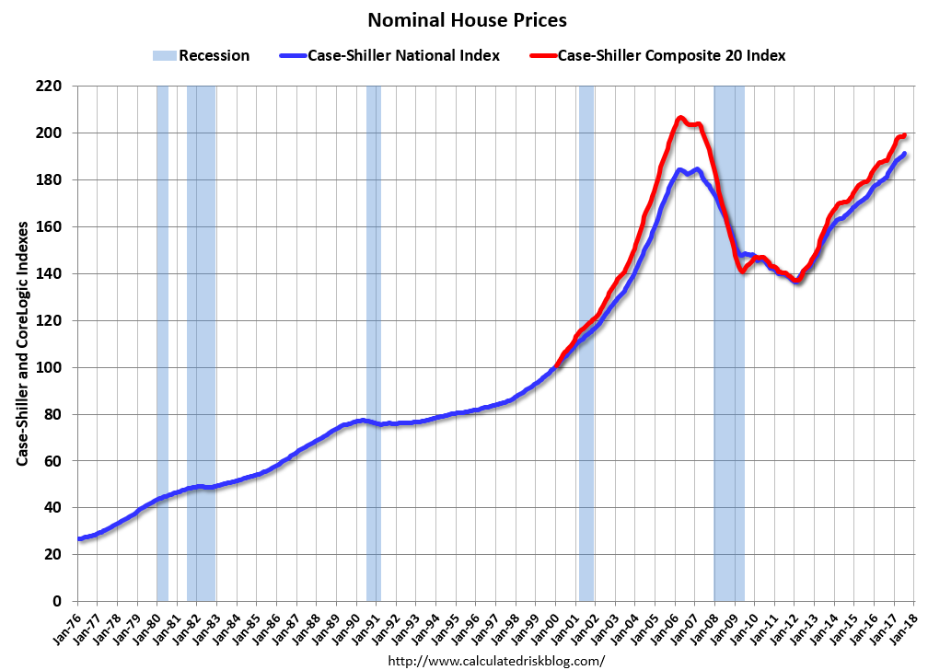

Slide 23
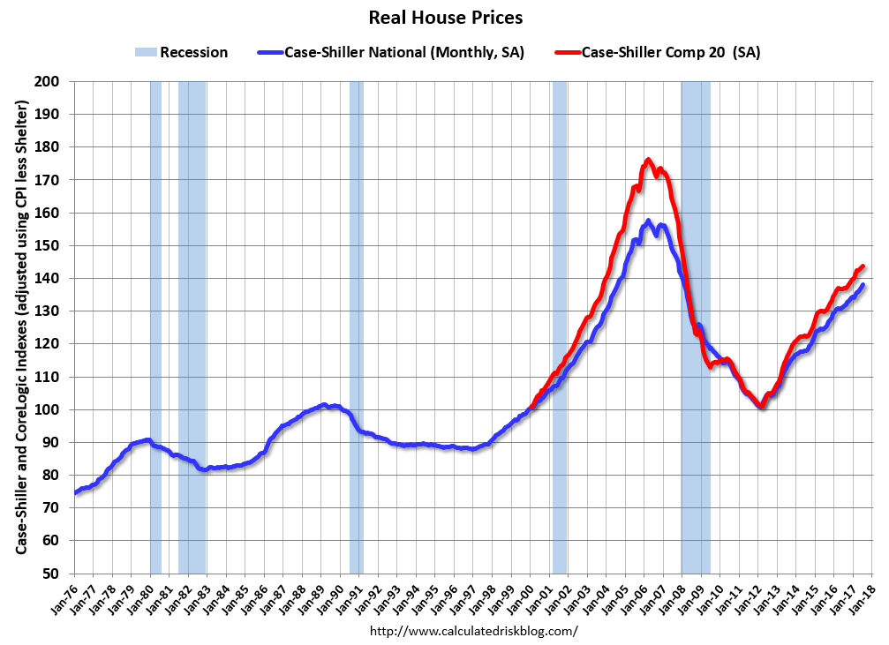

Slide 24
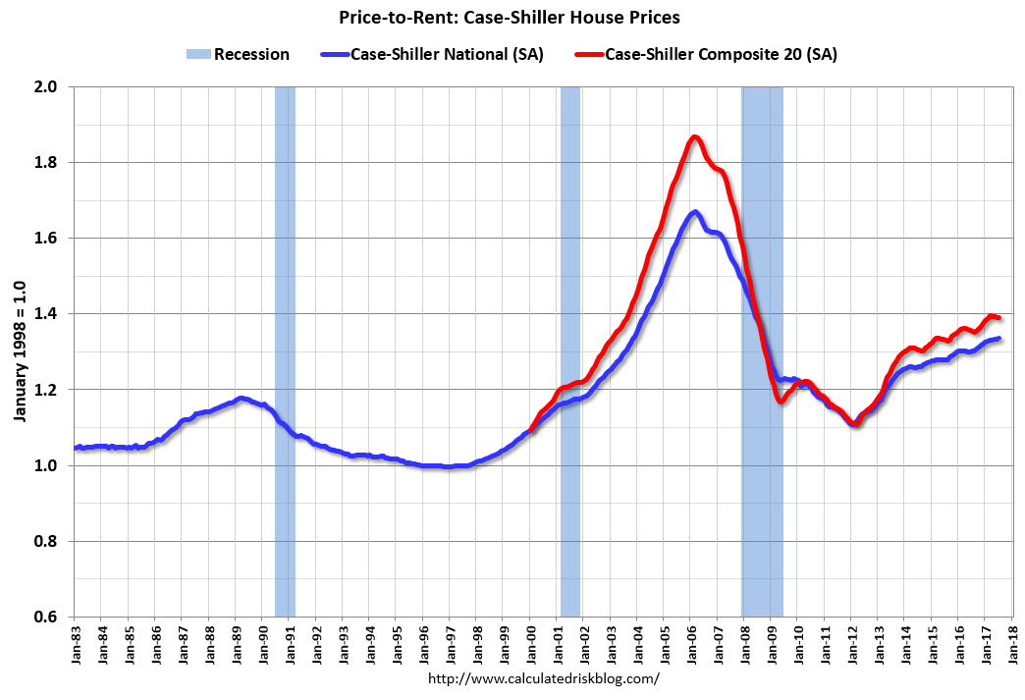

Slide 25
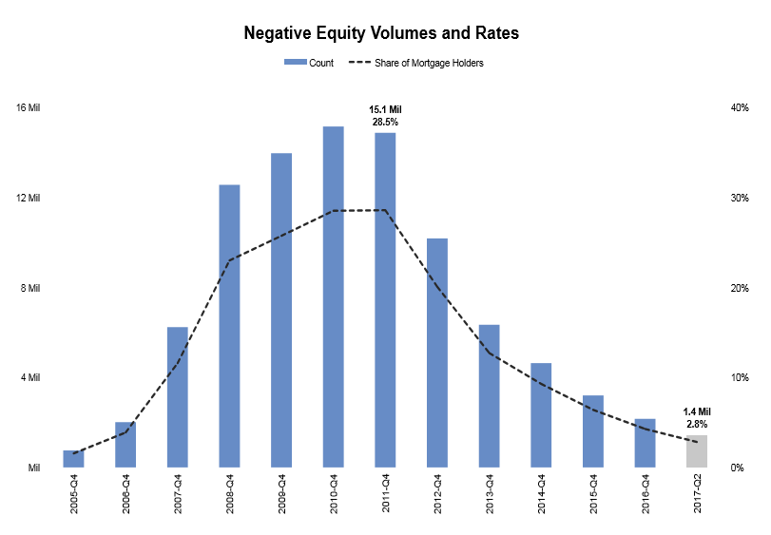

Slide 26
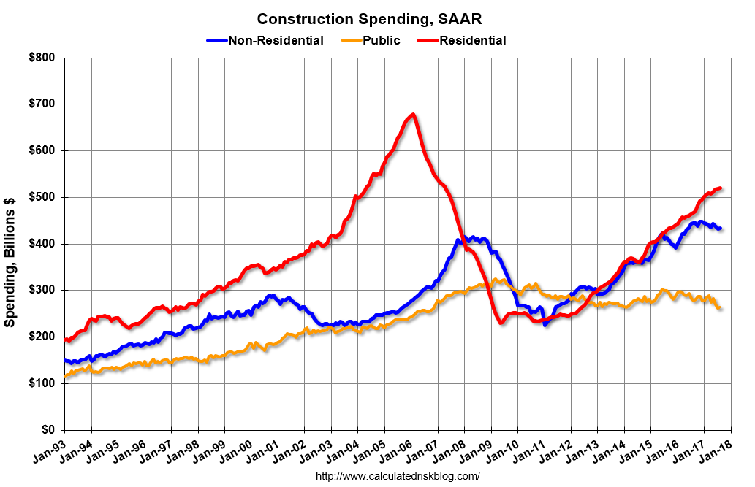

Slide 27
Current Policy Stance – Monetary Policy
Fed has raised interest rates another quarter point three times in 2017
Their favorite inflation measure is still below 2% target
  But wage growth above that
Unemployment figures now very low
A continued rising trend in interest rates will keep the dollar from falling too far against other major currencies
This will help keep inflation down
  Commodity prices too

Slide 28
Janet Yellen on Future Inflation
“I expect inflation to move higher next year. Most of my colleagues on the FOMC agree. In the latest Summary of Economic Projections, my colleagues and I project inflation to move higher next year and to reach 2 percent by 2019.”
Wage trends support this view
However, the failure to pass an infrastructure bill or any substantial fiscal stimulus (tax cut notwithstanding) suggests that inflationary pressures won’t be too high
And the “emratio” still isn’t anywhere near previous peak – Do we still have hidden slack in the labor market?

Slide 29
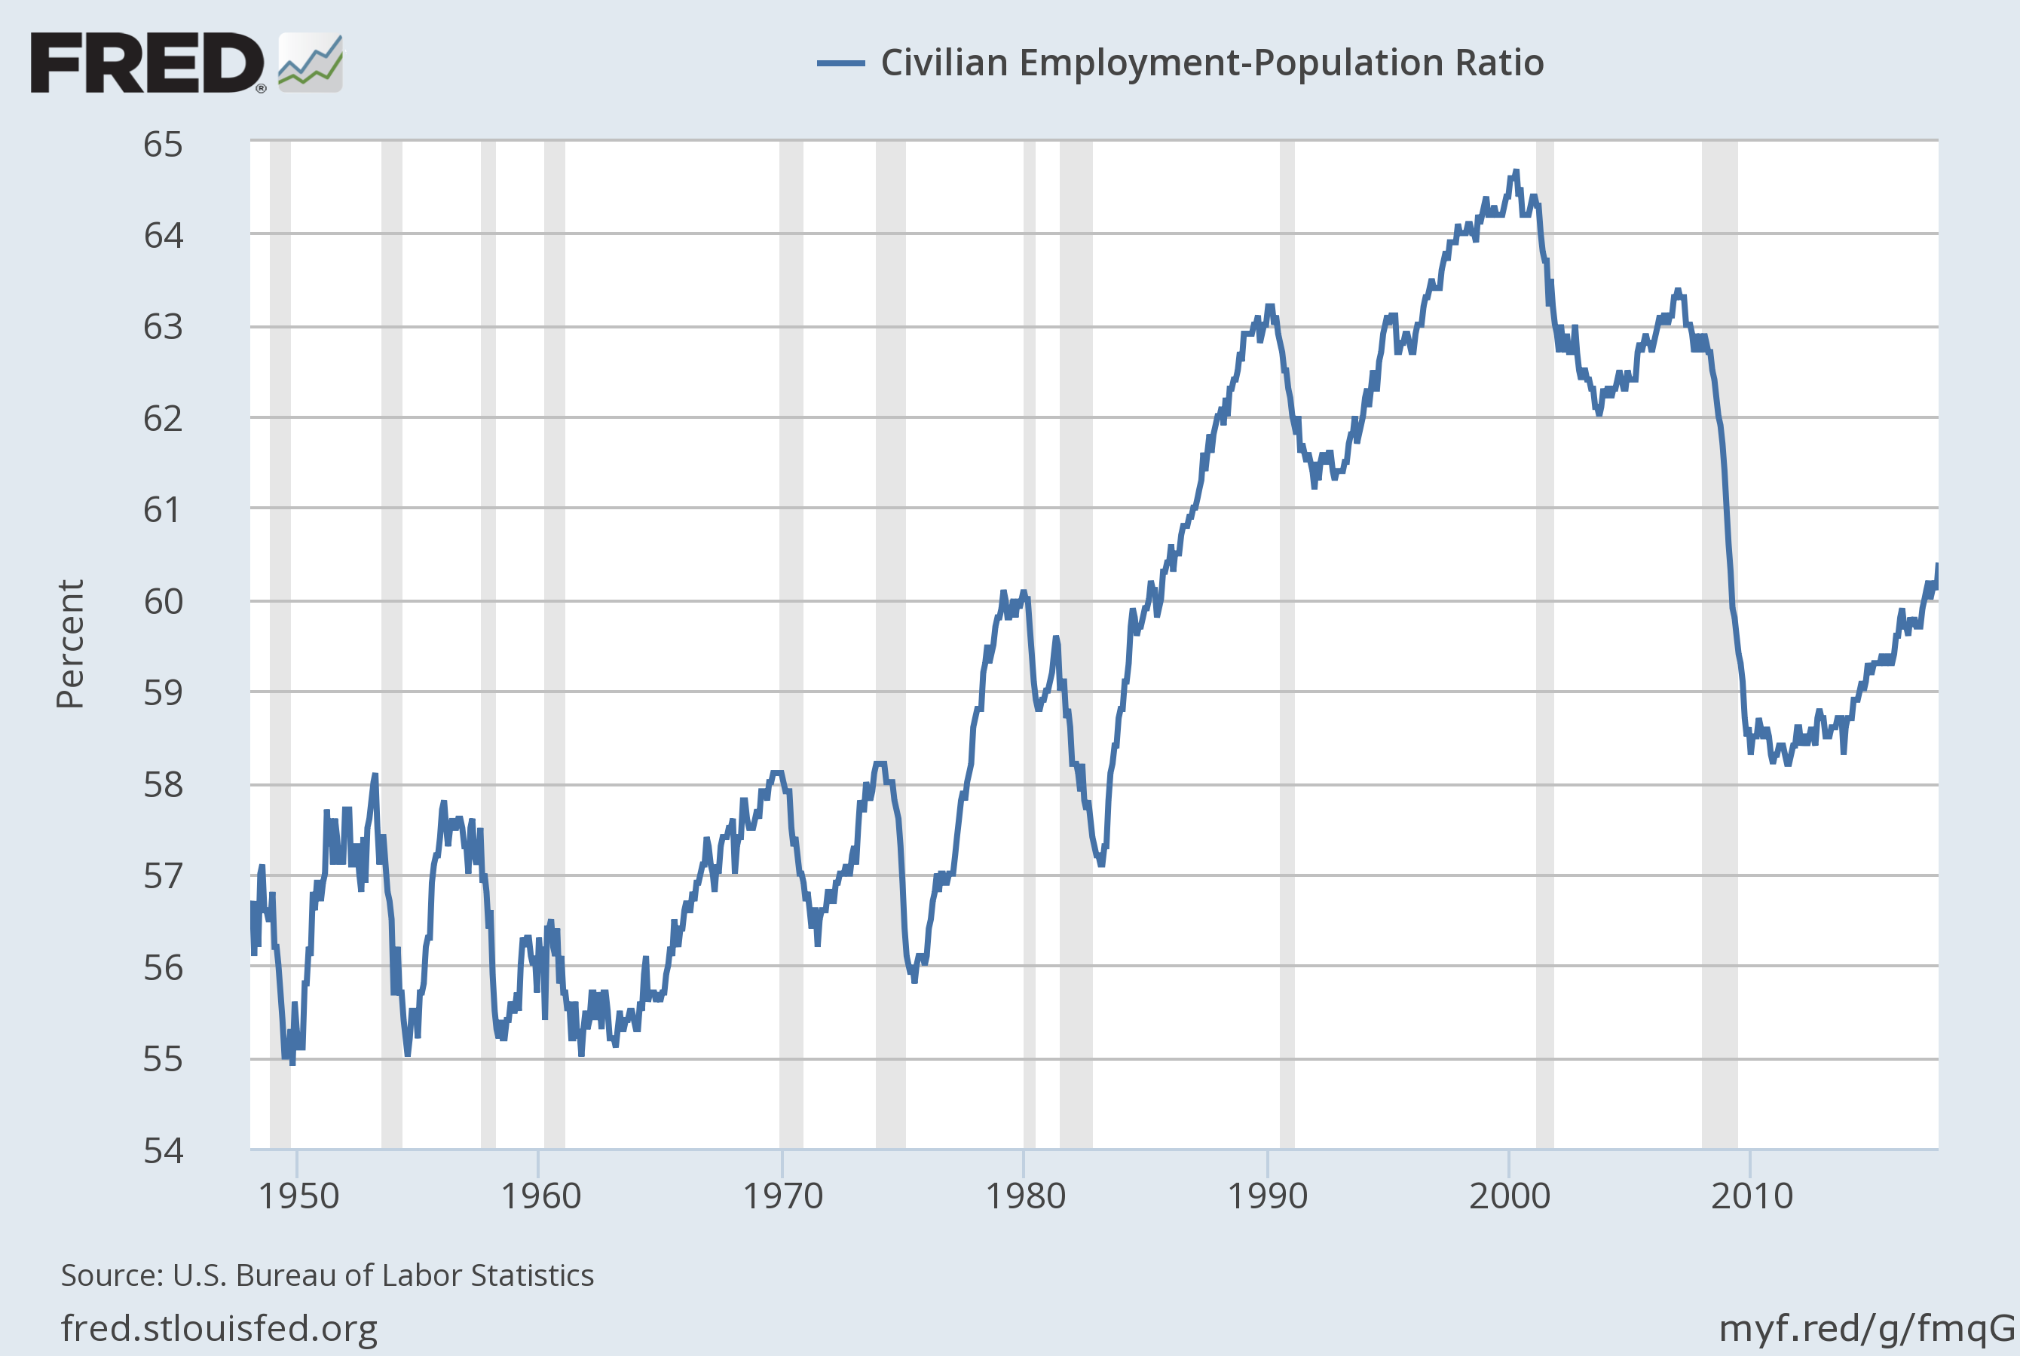
Broadest measure of employment still trending up but well below previous peak
even with overall unemployment at 4.1%
Notes:
Source:
U.S. Bureau of Labor Statistics
Release:
Employment Situation
Units:
Percent, Seasonally Adjusted
Frequency:
Monthly
The series comes from the 'Current Population Survey (Household Survey)'The source code is: LNS12300000
U.S. Bureau of Labor Statistics,
Civilian Employment-Population Ratio [EMRATIO],
retrieved from FRED,
Federal Reserve Bank of St. Louis;
https://fred.stlouisfed.org/series/EMRATIO,
October 24, 2017.

Slide 30
Trump and the Fed’s New Members
We really want competence and not politics in these jobs, especially the Chair
We have had that in both Bernanke (republican appointee) and Yellen (democratic appointee)
Trump’s penchant for appointees who don’t believe in the mission of their agencies is downright scary in this case

Slide 31
Good News! Jerome Powell is a Reasonable Pick (though not an economist)
Reappointing Janet Yellen would have been a very reassuring move
  She has done a good job
  Literally no change from Bernanke policies when she took over
  Competent non-ideological people see the same reality
Appointing John Taylor would not
  Yes he is famous as the author of the “Taylor rule”
  He was completely and totally wrong with his inflation prediction in 2009
  Worse, he has refused to admit it!
Jerome Powell next best thing to reappointing Yellen

Slide 32
Jerome Powell and ????
Four question marks for a reason – Trump will have 4 more vacancies on the Fed Board of Governors to fill
  Historically unprecedented
  System designed so this kind of thing doesn’t happen
  14 year appointments with one coming every two years but early resignations caused 5 vacancies including Chair and Vice Chair
Trump could cause problems if he makes ideological appointments
However, Trump wants low interest rates !!!!! His appointments are thus likely to be very much in line with Yellen’s (and now Powell’s) cautious approach to raising rates

Slide 33
Dollar remains pretty strong

Slide 34
Current Policy Stance: Fiscal Policy
Over past 7 years, freezing spending levels in a growing economy implies a gradual tightening in per capita terms –
Deficit now clearly under control
New spending on infrastructure or other public investment?
  We NEED it
  Whether we get it is a political decision
The above is exactly what I said a year ago

Slide 35
Tax Bill: Better than Congressional Paralysis?
Putting our corporate tax rate more in line with other countries is not a bad idea. But you have to get revenue from somewhere
Massive tax cut but money goes to corporations who already have lots of cash and rich people who won’t spend much of it
SALT and mortgage interest deduction capped – Do YOU live in a high tax state?
Boon for corporations with overseas cash hoards

Slide 36
On Taxes
Big tax cuts for repatriation of overseas profits
  We have done this before and the result was higher dividends, not investment
  No reason to expect otherwise this time –corporations are flush with cash here in the USA and if they aren’t using that for new plant & equipment why would more cash change that?

Slide 37
When is a Good Time for a Tax Cut?
In a recession – not at the peak of the business cycle
If we DID want an economic stimulus we need to give $ to people who will spend it, not to corps who already have lots of cash or rich people who will bank it – BUT NOW IS NOT THE TIME FOR A STIMULUS
SCK says “Enough with the tax cuts – There may have been a point to the anti tax campaign years ago but now it is just a residual political reflex”

Slide 38
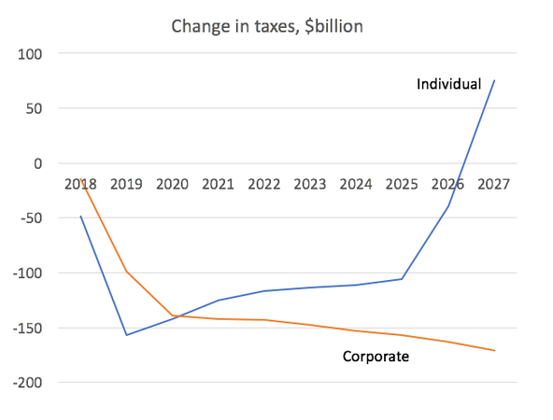
The Congressional Joint Committee on Taxation’s estimate of the effect of the Senate tax bill
They can pass a 10 year bill but do you really believe they will leave it alone for a decade?

Slide 39
And the Chaos in Washington continues …….
I imagined I knew what undivided Republican government would bring and finally we have at least some of that – a tax cut!
But we have two dynamics that seem to make further progress of any kind impossible:
  In the White House Mr. Trump seems to have no opinions, hence no leadership – and on top of that I hardly need to tell you all that he seems to be a chaos generator of the first order (to put it politely)
  The Republicans now control all branches of government but have gone from not agreeing with themselves to occasional outright civil war
Your guess about where this goes is as good as mine. My guess is continued fiscal paralysis (which means operationally a continued gradual tightening on a per capita basis or as a percent of GDP)

Slide 40
Retail Sales and Household Debt
Unemployment very low
Household debt continues to be low as a percent of GDP
So no reason for consumption to be a drag on growth

Slide 41
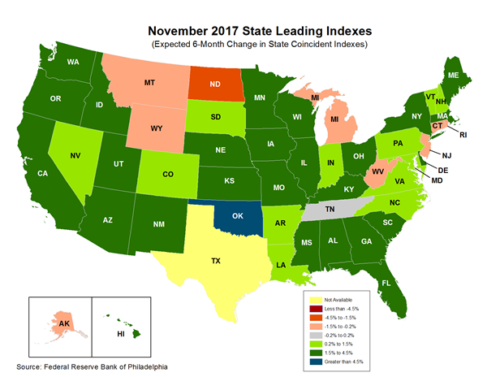
Most Recent Leading Index from Philadelphia Fed (November 2017)

Slide 42
Leading Indexes from a Year Ago (Nov. 2016)

Slide 43
Predictions
GDP growth at around 2 - 2.5%;
Unemployment – Current rate pretty nearly as low as it will go – If GDP keeps growing, unemployment should stay low - 3.9%
Inflation – Will remain low but above the 2% target for the first time in 5 years
Interest rates –– Will go up but only a ¼% at a time – 2% by year end 2018
Fiscal Policy? The big question … I am predicting continued paralysis and short term continuing resolutions
Exchange Rate: Higher interest rates mean a continued strong dollar which will help dampen inflation but also commodity prices

Slide 44
Stock Market
Caveat Emptor!!!! This slide is worth exactly as much as you paid for it – I include it not because I think I have any great prediction edge but because I always get asked this question
Why is the stock market high? Profits are high, companies are awash in cash and with Republicans in control the worst that can happen to corporations is nothing. (Or they might get a tax break and/or regulatory relief)
Where will it go? I think the good news is already priced in. Hard to imagine the next year will be as good as the past one

Slide 45
The Big Unknown
A constitutional crisis brewing?
Two ways to get one (there might be more)
  Fire Mueller before the investigation is finished
  Mueller finishes but a large part of the population (and/or the Republican majority in Congress) refuses to accept the results
Your guess is as good as mine !!

